Slide 1
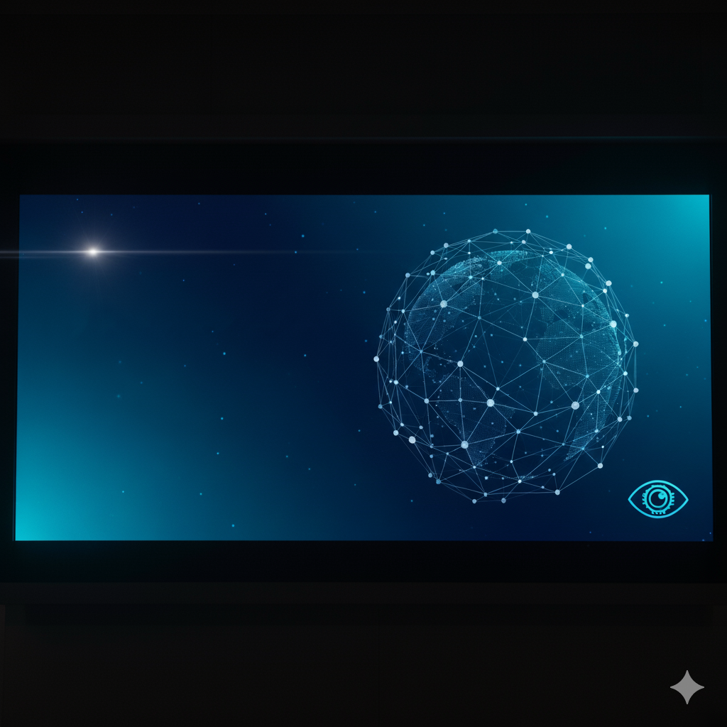
AI Project Hub:
An End-to-End Application for Real-World Computer Vision
By:
Chirag Avasthi

Slide 2
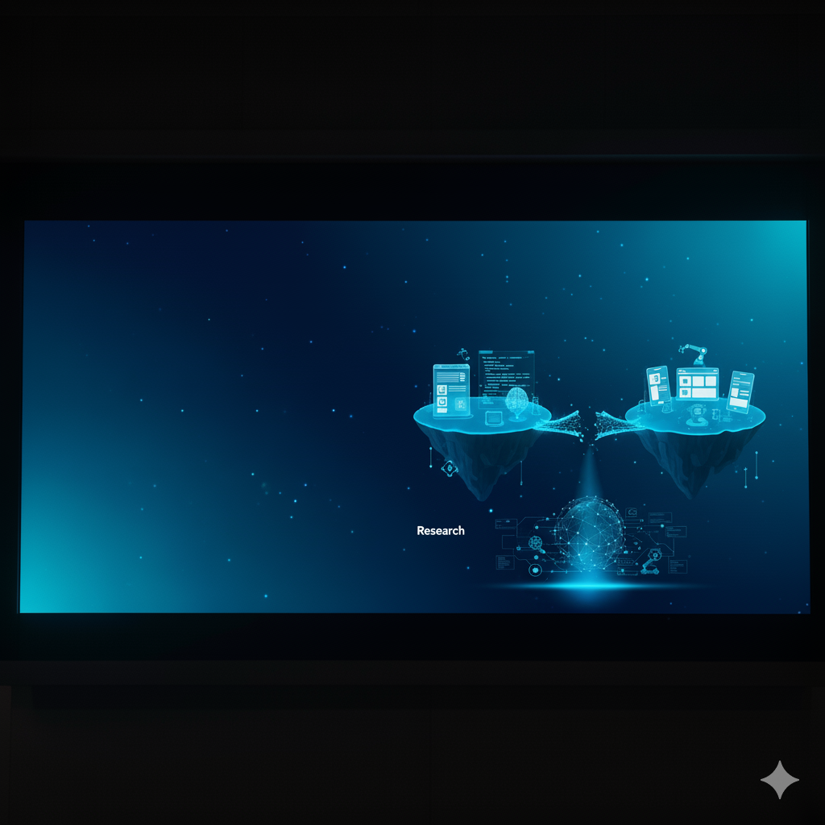
The Problem: Bridging the Gap
Many powerful AI and computer vision models exists only in research papers or complex code notebooks.
There's a significant gap between developing a model and making it interactive, accessible, and useful for a non-technical user.
The Vision: To build a single, robust web platform that not only showcases different CV techniques but also demonstrates the complete end-to-end process of deploying a custom-trained deep learning model into a real-world application.

Slide 3
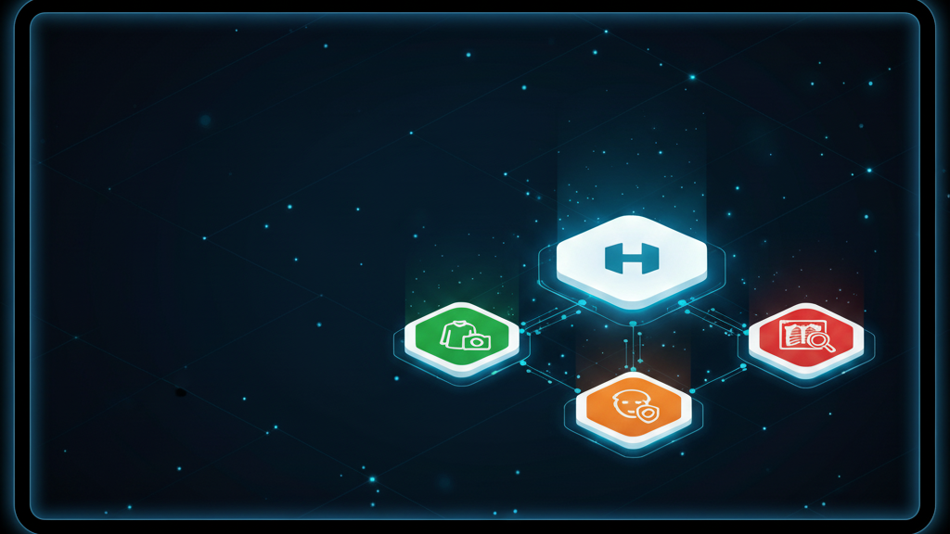
The Solution:
A Unified, Interactive Platform
A full-stack web application built with Flask and modern frontend technologies.
Features a central, user-friendly homepage that directs users to three distinct, powerful computer vision modules.
Each module is self-contained and demonstrates a different level of AI complexity.

Slide 4
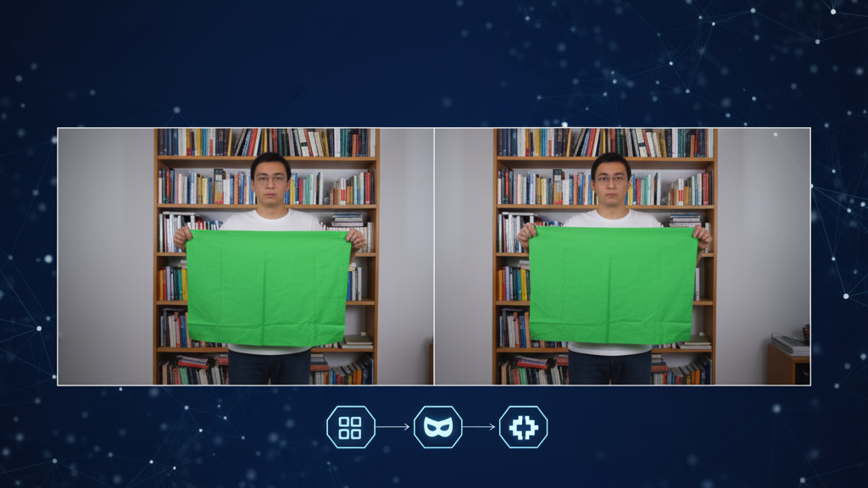
Feature 1 - The Invisible Cloak
Mastery of Traditional Computer Vision
Goal:
To create a real-time "invisibility" effect using a specific-colored object.
Technology:
This module relies on fundamental, classical computer vision algorithms, not machine learning.
Key Techniques Used:
Real-time video capture and processing with OpenCV.
Color Space Conversion (BGR to HSV) for reliable color detection.
Color Masking and Bitwise Operations to isolate the cloak and seamlessly blend the background.

Slide 5
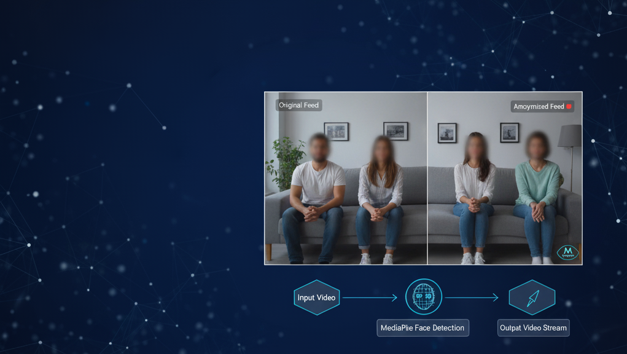
Feature 2 - The Face Anonymizer
Leveraging State-of-the-Art Pre-Trained Models
Goal:
To detect and blur faces in a live video stream to protect privacy.
Technology:
This module utilizes a highly optimized, pre-trained deep learning model for real-time inference.
Key Techniques Used:
Google's MediaPipe library for high-performance face detection.
Applying image processing filters (Gaussian Blur) on the detected regions (bounding boxes).
Demonstrates the practical application of using existing state-of-the-art models for a specific task.

Slide 6
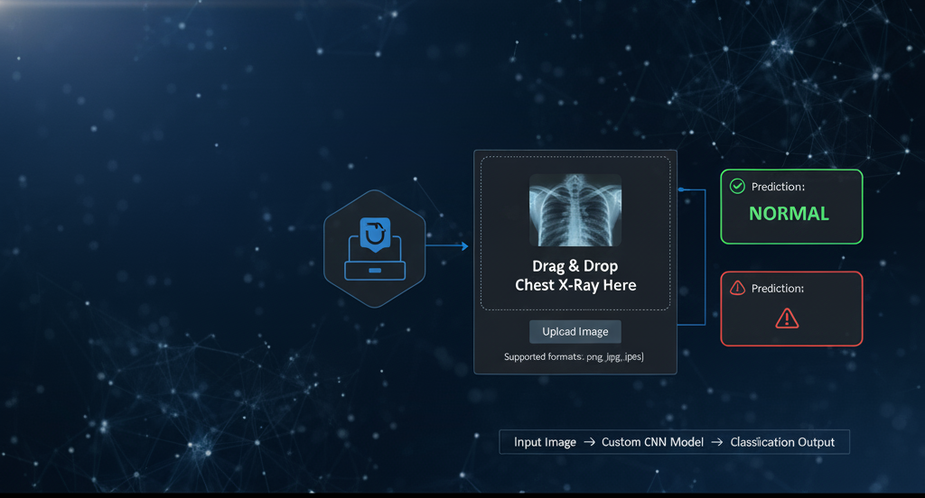
Feature 3 - The Pneumonia Detector
An End-to-End Deep Learning Solution
Goal:
To classify a user-uploaded chest X-ray image as either “NORMAL” or showing signs of “PNEUMONIA”.
This is the core of the project, showcasing the full data science lifecycle from model training to deployment.
The application features a clean drag-and-drop interface for a seamless user experience.
The Model:
A custom Convolutional Neural Network (CNN) that I trained from scratch.

Slide 7
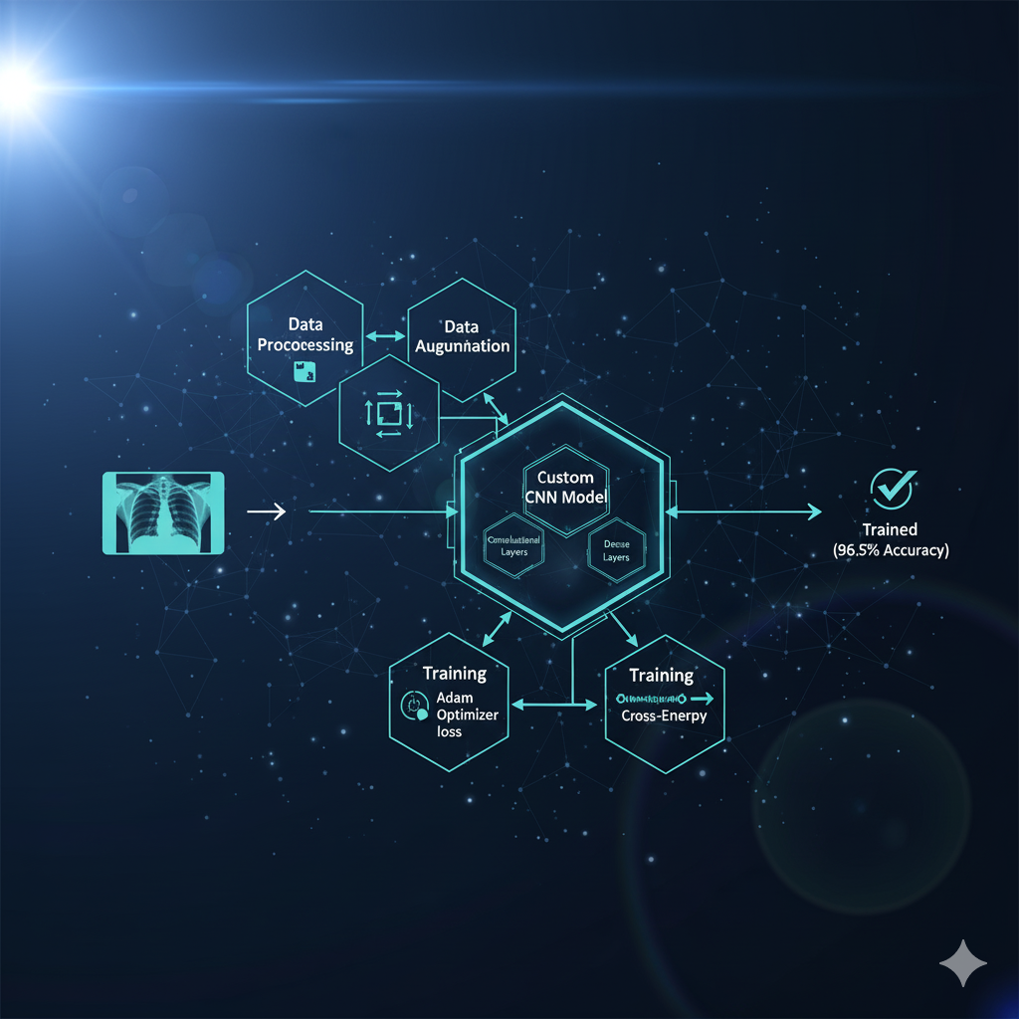
Deep Dive - The Custom CNN Model
Training a High-Accuracy Medical Imaging Classifier
Dataset:
I utilized the "Chest X-Ray Images (Pneumonia)" dataset from Kaggle, which contains over 9,800 labeled images.
Data Preprocessing & Augmentation:
All images were resized to 256x256 pixels.
Applied data augmentation techniques (rotation, zoom, horizontal flips) to prevent overfitting and improve the model's robustness.
Model Architecture:
I designed and implemented a custom CNN architecture in TensorFlow/Keras. It consists of multiple convolutional and pooling layers to extract features, followed by dense layers for classification.
Training & Results:
The model was trained using the Adam optimizer and Binary Cross-Entropy loss function.
After extensive training and hyperparameter tuning, the model achieved 96.5% accuracy on the unseen test set, demonstrating high reliability.

Slide 8
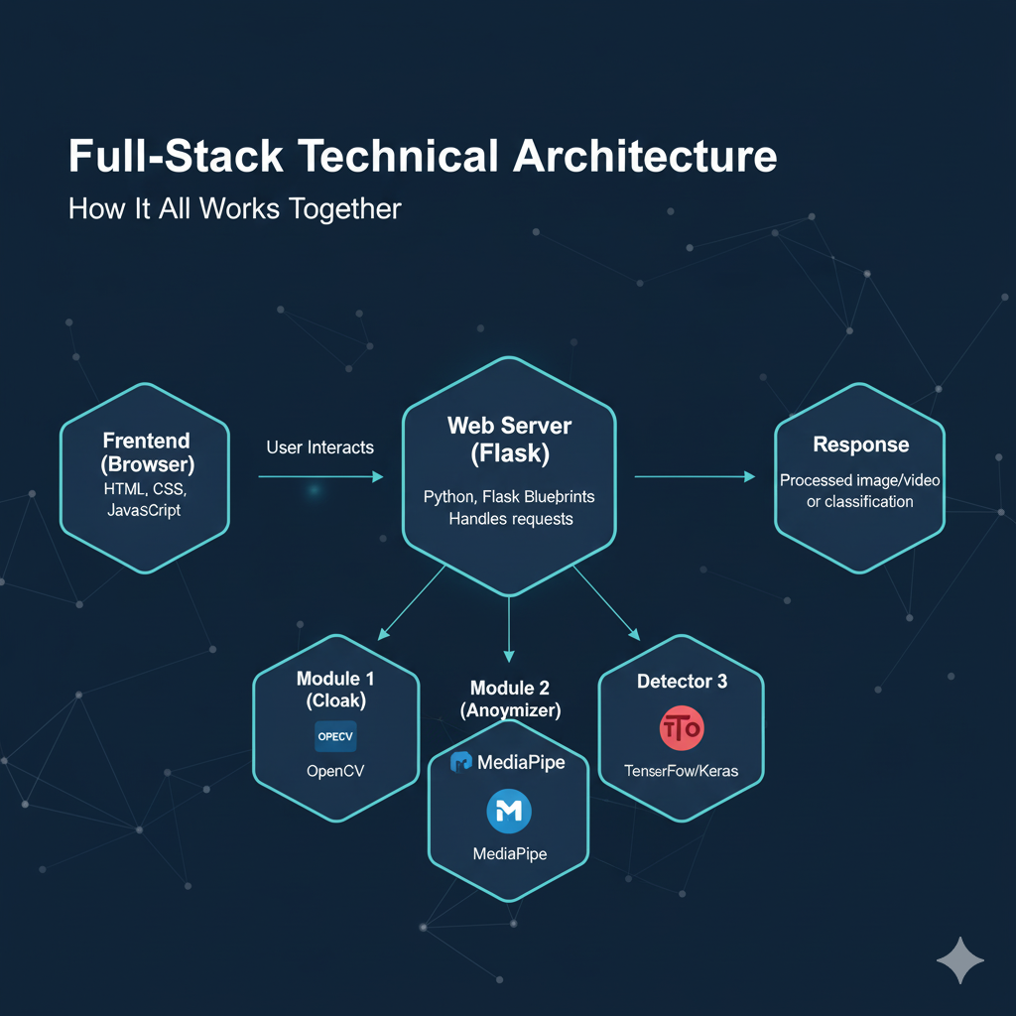

Slide 9
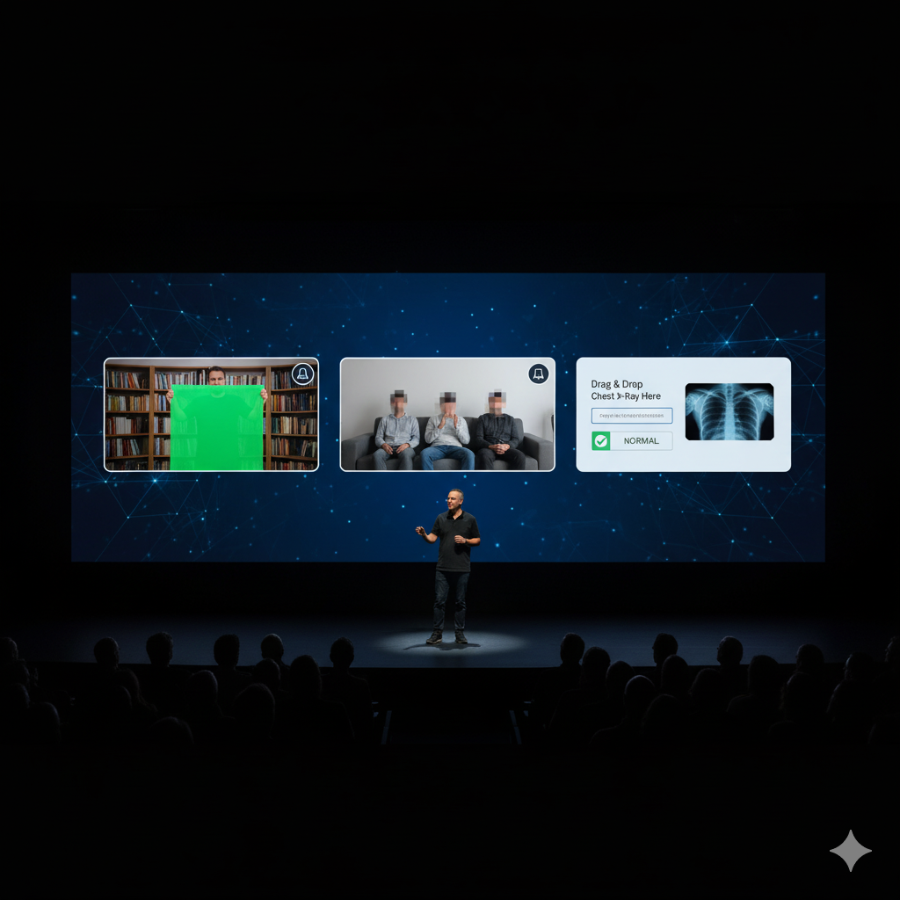
Live Demo

Slide 10
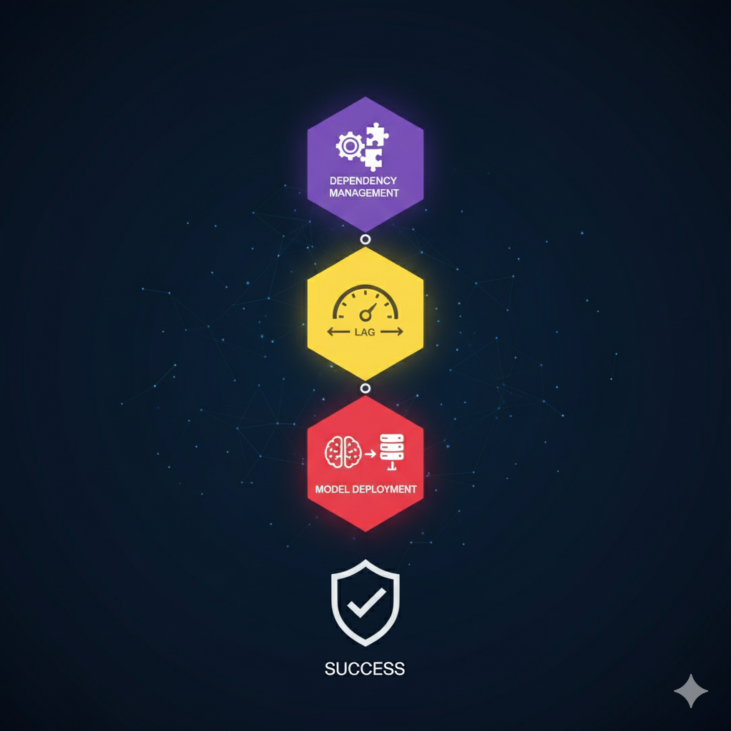

Challenges & Learnings
Overcoming Technical Hurdles
Dependency Management:
Resolving complex version conflicts between major libraries like TensorFlow, OpenCV, and MediaPipe was a significant challenge that required careful environment management.
Real-Time Performance:
Optimizing the video processing loop in Flask to ensure a smooth, lag-free video stream to the browser was a key learning experience.
Model Deployment:
Bridging the gap between a trained Keras model (.h5 file) and a live Flask application taught me the critical steps of model deployment and preprocessing for inference.

Slide 11
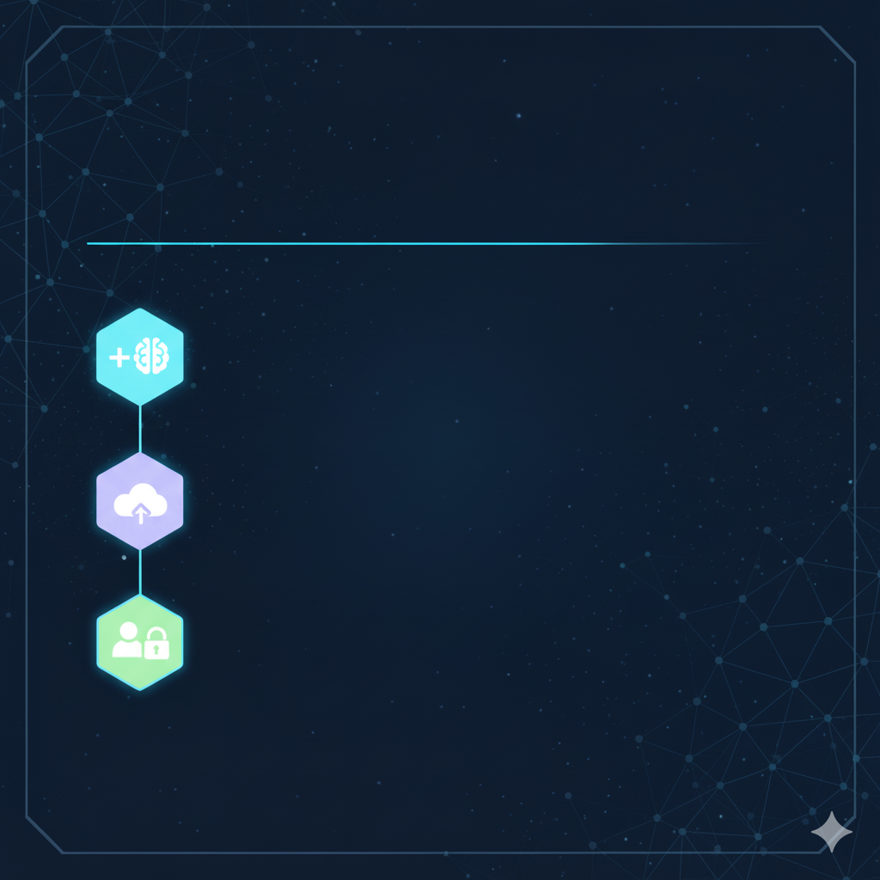
Future Work:
Next Steps & Potential Enhancements
Add More Models:
Integrate other computer vision models (e.g., object detection, image segmentation) into the hub.
Cloud Deployment:
Deploy the application to a cloud service like Heroku or AWS so it's publicly accessible.
User Accounts:
Allow users to create accounts to save their analysis history (e.g., past X-ray uploads).

Slide 12
Conclusion :
Successfully built a full-stack, end-to-end deep learning application that is both functional and user-friendly.
Demonstrated a wide range of skills, from traditional CV to custom model training and deployment.
The scalable blueprint architecture allows for easy expansion and addition of new AI features in the future.
Thank You!
Developer: Chirag Avasthi
Contact: chiragavasthi24@gmail.com
GitHub: https://github.com/ChiragAvasthi
LinkedIn: www.linkedin.com/in/chirag-avasthi-b6b086293

